Slide 1

Title
Author name(s) and Advisor name
Stark State College, North Canton, Ohio 44720.

Slide 2
How to give a great speech: convey your story and convince your audience.
Tell a compelling and cohesive story by building a flow and providing a clear connection between the slides.
Here is a simple and direct approach by Aristotle whenever you need to give a presentation: "Tell them what you are going to tell them, tell them, then tell them what you told them.“

Slide 3
Also….
Be Sure to Proofread!
Ask yourself “Do the slides connect? Do they tell a story?” If needed, shuffle your slides to find a cleaner way for the concepts to fit together.
Use slides to illustrate your points (not vice versa)
Be Sure to Practice your Oral Presentation!
  Practice to become very familiar with it
  Practice to time it – 10 min or less.
  Talk to the audience and not the screen (eye contact)

Slide 4
Introduction / Outline / Overview
Introduce your topic to the audience
Use bullet points to simplify the outline or introduction.
Try to keep a short and simple list. A long list with more than five bullet points with too many words can be a distraction for an audience.

Slide 5
Key design elements
Use simple and clean design themes
Keep slide animations between slides to a minimum
Be consistent throughout the presentation with the font and the size of text
Do not capitalize every word in your slide.
Prepare uncluttered slides

Slide 6
Key design elements
Use text that is easy for the audience to read.
Use dark letters on a light color or white background. Try to use high contrast combinations.
Stay away from using a red or bright green background color. For example, red-green or yellow-green color combinations can be very difficult to read.
Additional information: see YouTube video “Susan McConnell (Stanford): Designing effective scientific presentations” https://youtu.be/Hp7Id3Yb9XQ

Slide 7
Prepare easy to read slides
Verdana is an easy to read font, 32 point
Arial is a popular font, 32 point, and Helvetica too
Calibri – one size up is recommended, this is 36 point
Times New Roman is a nice looking font, 32 point

Slide 8
Hard to read slides generally have too much text and/or too small font.
Lucida handwriting is more difficult to read
Ar Berkley is more difficult to read
Kristen ITC does not look professional, 20 point too small for a slide
Helvetica, but small font size, 20 point is too small for a slide
You want to have some white space on the slide so that it doesn’t look busy
You can have text and graphics on one slide – be sure both are easy to read
Do not fill up the slide with text and graphics
Color can add to a presentation, but keep it simple
Remember that the slides do not and should not contain all of the words you will speak
If in doubt, increase the size

Slide 9
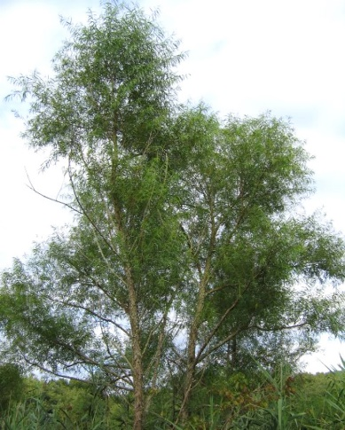
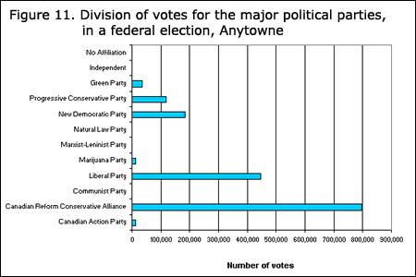
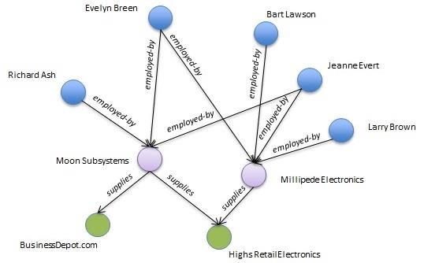
Do not use too small or low quality images.

Slide 10
Don’t do this either!
Dark background and not enough contrast between
words and background = hard to read slide

Slide 11
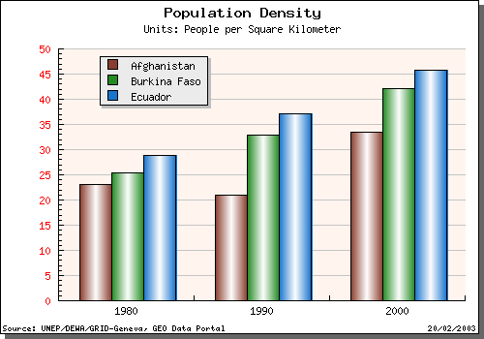
Use large and high quality images
Figures must include a short caption giving a brief description. Ensure that any symbols and abbreviations is explained in your talk. Modify figures if needed to emphasize your point.

Slide 12
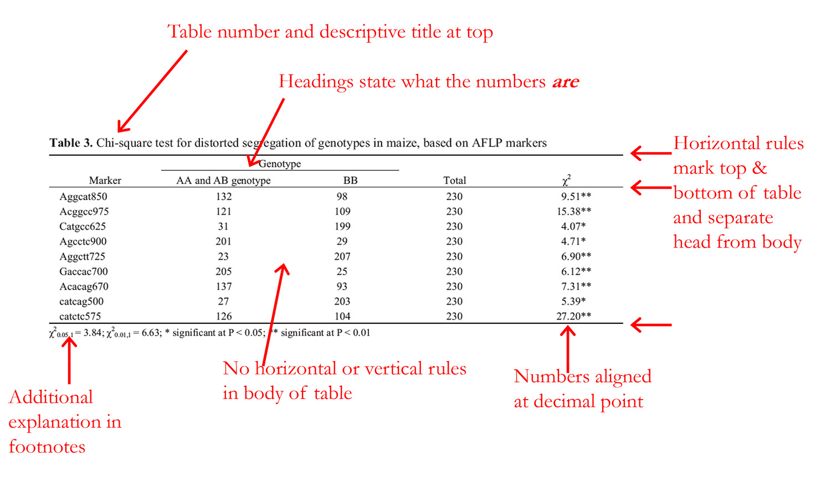
Present your results using simple and uncluttered charts or tables:
Replace large detailed tables with charts or small and simplified tables.
Accompany tables or charts with bulleted annotations of major findings.
Spell out acronyms if used.
**The numbers in this table are too small for audience to read easily.
Notes:
https://www.pomona.edu/administration/writing-center/student-resources/writing-science-and-math/writing-sciences/bio-40-lab-how-create-table-your-lab-report

Slide 13
Content Slides….
If applicable

Slide 14
Conclusions
If applicable

Slide 15
Acknowledgments
Acknowledge anyone who significantly helped you putting this presentation together.
The authors would like to thank ………for…….

Slide 16
References
It is the responsibility of authors to ensure the accuracy of references.
Please include all authors, and do not use “et al.”
The following format for journals (1), books (2), thesis (3), patents (4), and websites (5) must be used:
Balsara, N. P.; Fetters, L. J.; Hadjichristidis, N.; Lohse, D. J.; Han, C. C.; Graessley, W. W.; Krishnamoorti, R. Salt-Induced Association of Lactoglobulin by X-ray Scattering. Macromolecules 1999, 32, 6137–6147.
(2) Wignall, G. D. In Encyclopedia of Polymer Science and Engineering, 2nd ed.; Mark, H. F., Bikales, N. M., Overberger, C. C., Menges, G., Eds.; Wiley-Interscience: New York, 1999; Vol. 10, p 112.
(3) Author, Degree Thesis, University (location if not obvious), Month, Year.
(4) W. Lehmann, H. Rinke (Bayer AG) Ger. 838217, 1952.
(5) Author, Short description or title, URL, accessed: Month, Year.
Notes:
The some of the information was adapted or excerpt from http://pubs.acs.org/paragonplus/submission/jacsat/jacsat_authguide.pdf

